Slide 1

BATCH 2
SOLID REPORT

Slide 2
THIS WEEK’S OBJECTIVES
COOK 2 FULL GRAINS THROUGH MELTING AND RECASTING.
MAKE THE IGNITION CIRCUIT
FINALIZE ON GETTING THE 2 ½ INCH SCH40 PIPE *
START AND FINISH WORKING ON THE 1 GRAIN MOTOR CASE *

Slide 3
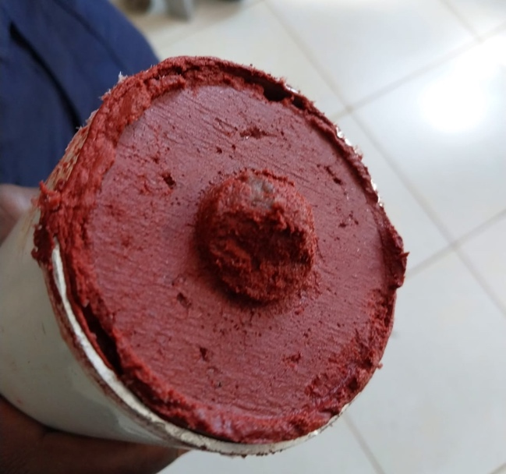
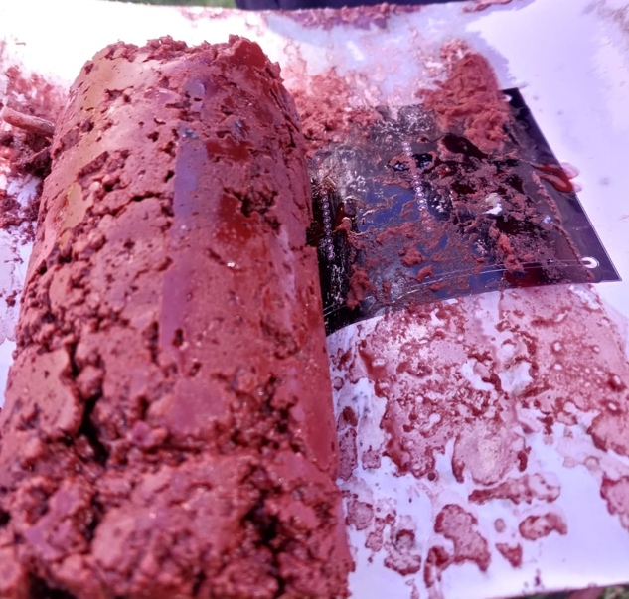
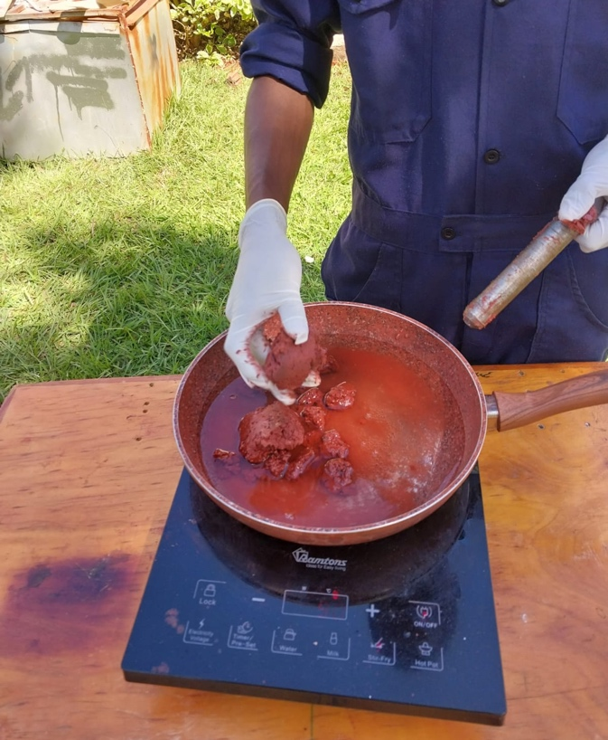
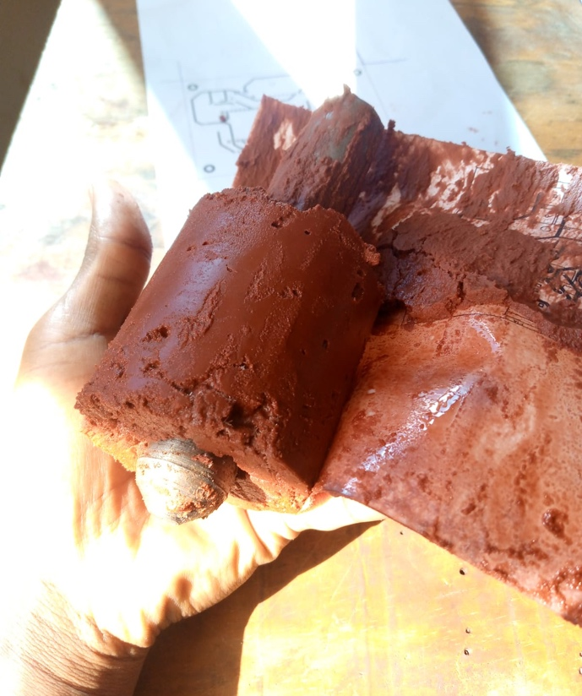
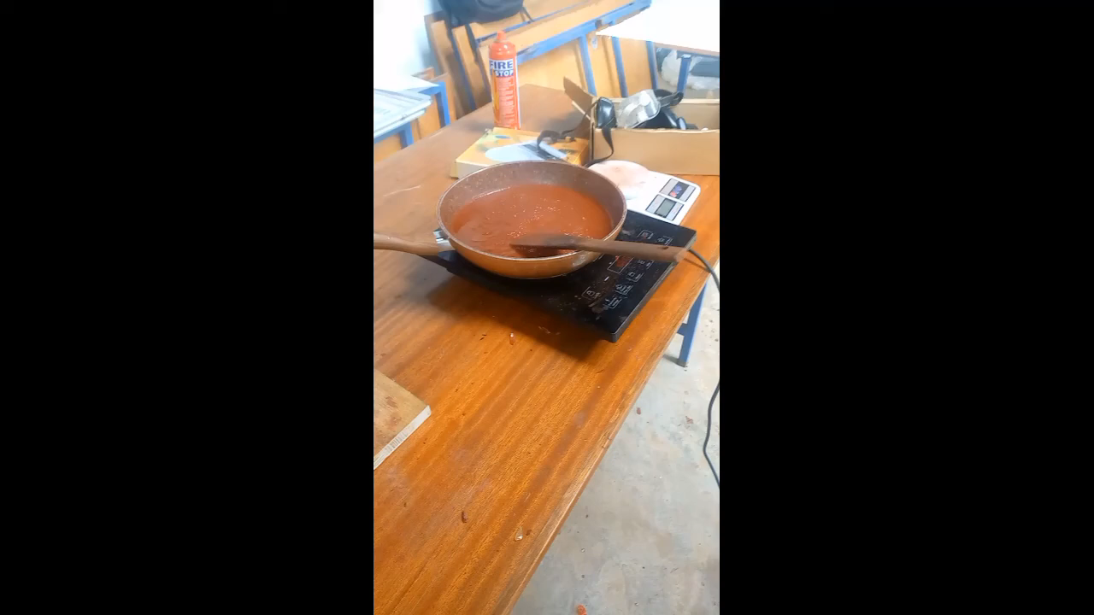
Comparison between the two cooking runs.

Slide 4
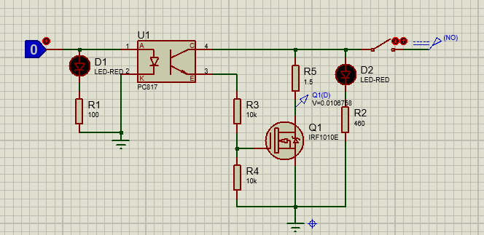
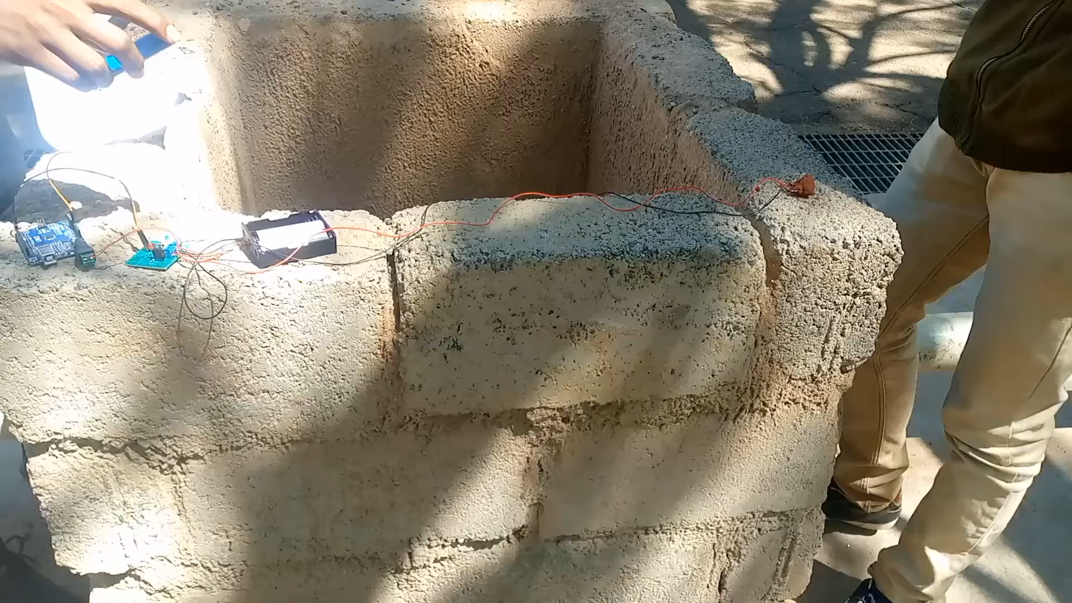
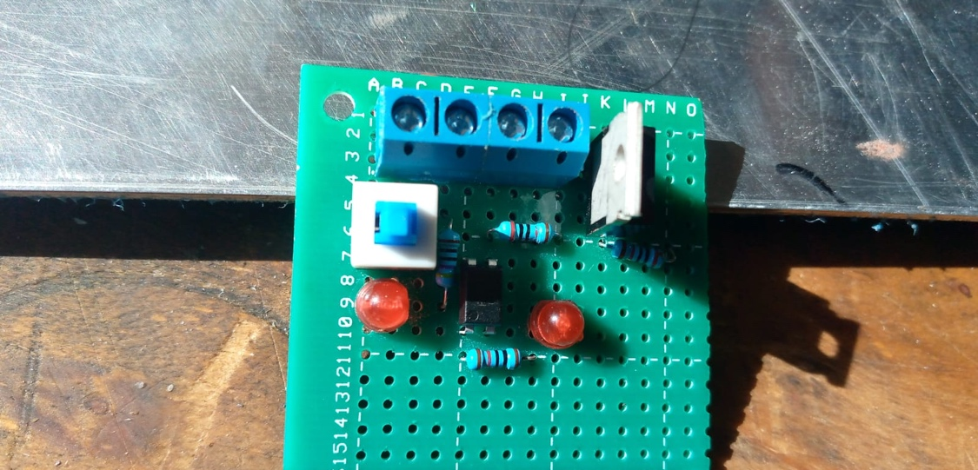
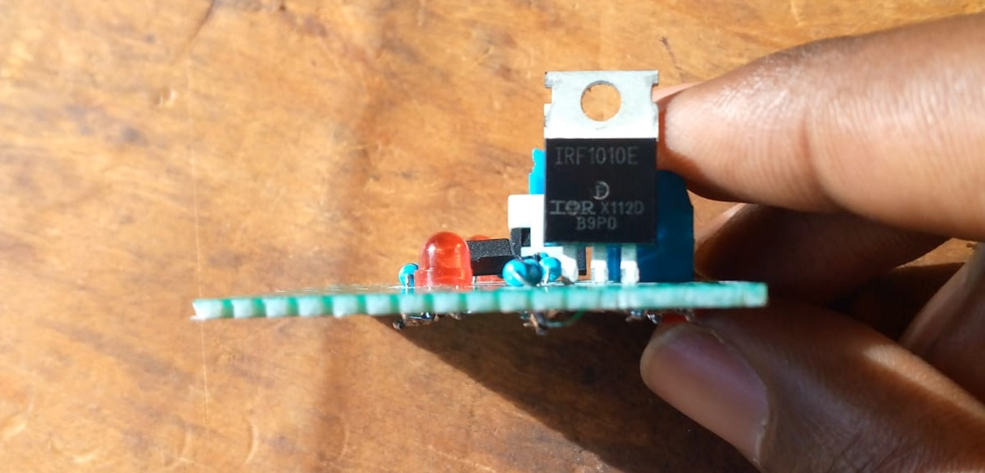
IGNITION CIRCUIT

Slide 5
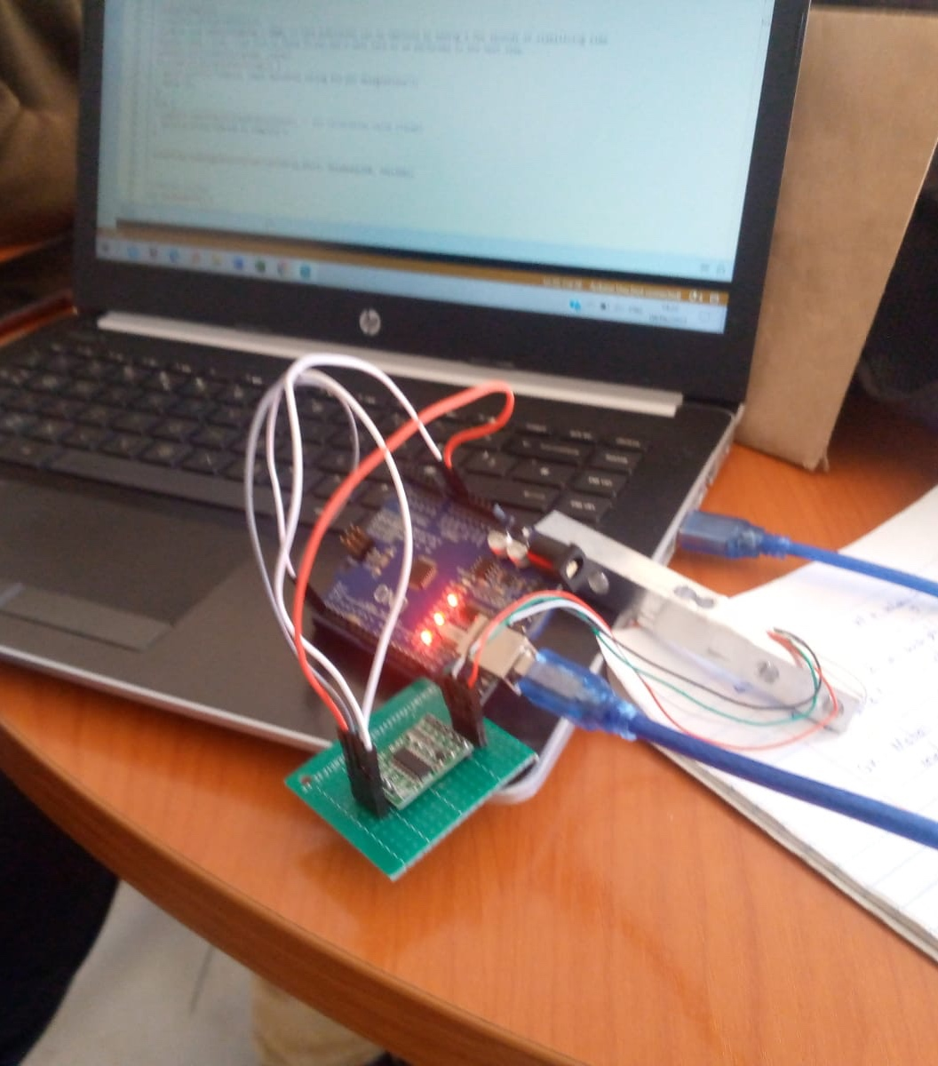
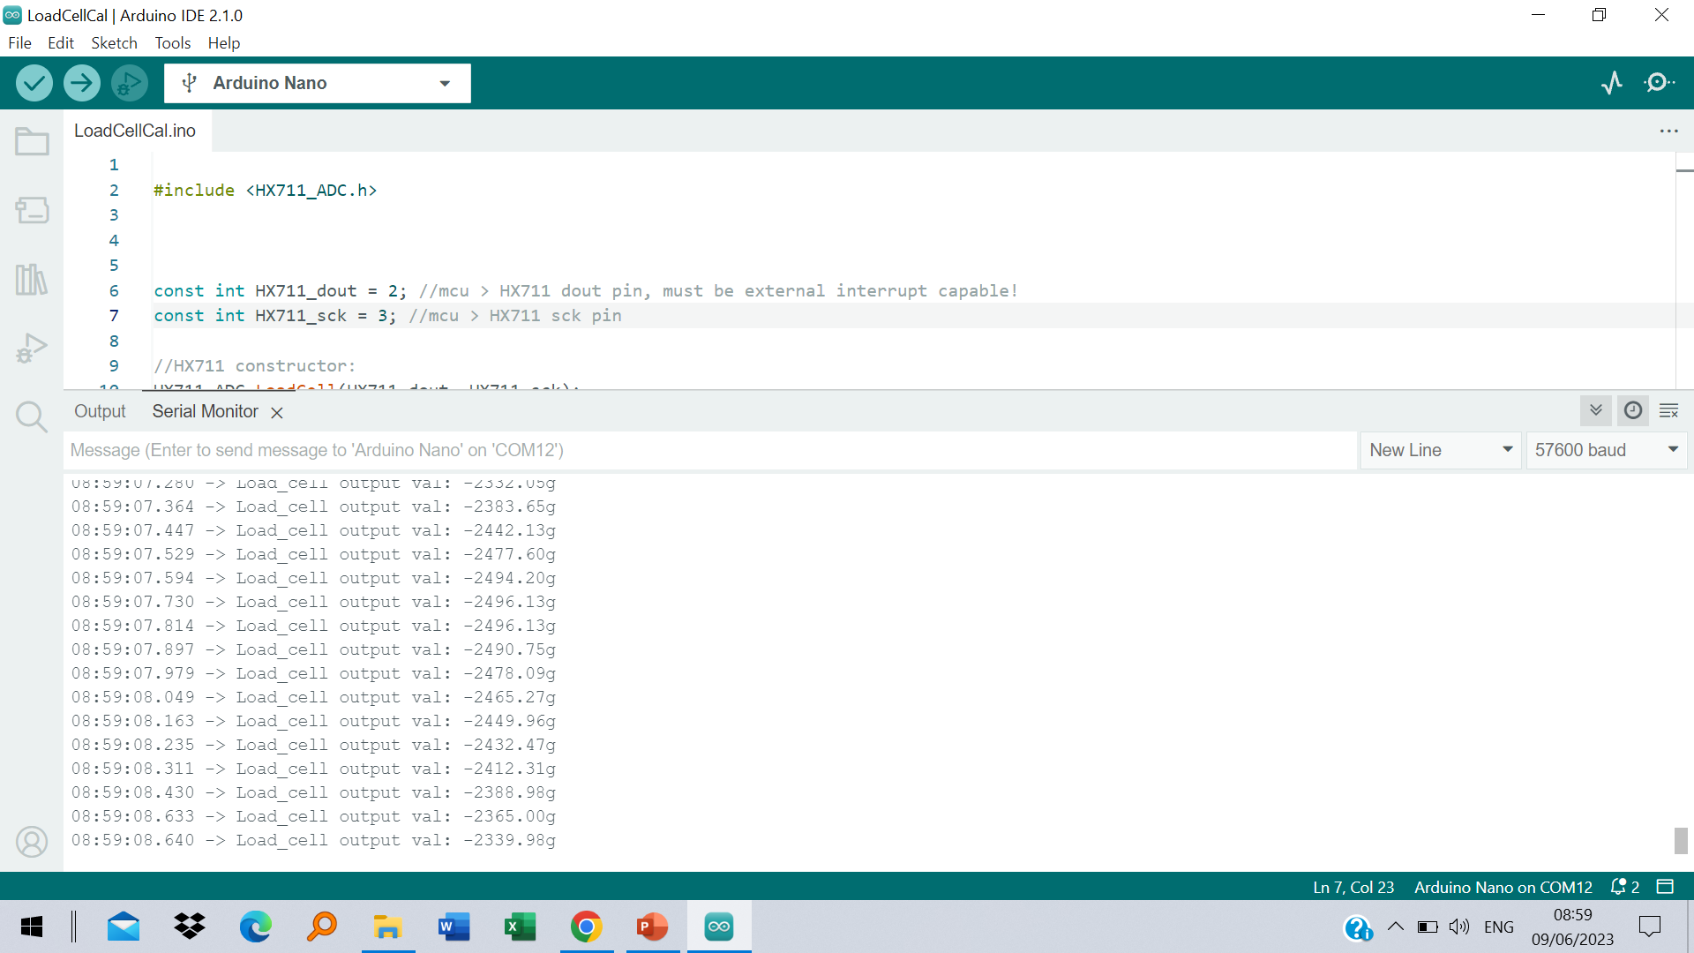
LOAD CELL: SETUP AND CALIBRATION.

Slide 6
CHALLENGES ENCOUNTERED.
1. GETTING THE 2 ½ INCH SCH40 PIPE FOR THE 1 GRAIN MOTOR CASING

Slide 7
NEXT WEEK’S OBJECTIVES.
1. FINALIZE ON GETTING THE 2 ½ INCH SCH40 PIPE.
1
2. START AND FINISH WORKING ON THE 1 GRAIN MOTOR CASE.
2
3. DESIGN & FABRICATE CASING FOR THE ELECTRONICS.
3
4. COOK GRAIN AND EXPLORE METHODS OF PRESERVATION.
4

